Slide 1
DIGITAL COMMUNICATIONS
MAJ IRV EMMONS, S-6
OREGON STATE DEFENSE FORCE
249TH REGIMENT, CAMP RILEA
http://emmonsfamily.us/Amateur_Radio.htm
K7QPP
AAR0SQ

Slide 2
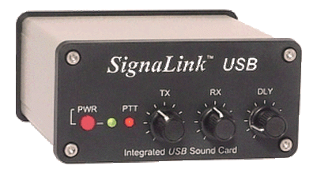
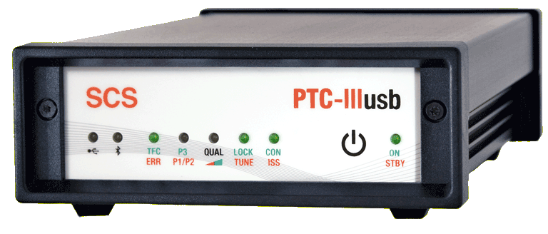

Common hardware
PACTOR
Tigertronics SignaLink USB
Interface
SCS PTC-IIIusb
DIGITAL MODE (KEYBOARD)
PACKET
WINMOR
Kantronics PacketCommunicator 3 Plus
K7QPP
AAR0SQ

Slide 3
Winlink 2000
Winlink 2000 (WL2K) is a worldwide system of volunteer sysops, radio stations and network assets supporting e-mail by radio, with non-commercial links to internet e-mail. These resources come from Amateur Radio, the Military Auxiliary Radio System (MARS), government agencies, and non-government volunteer organizations. The system provides valuable service to emergency communicators and to licensed radio operators without access to the internet.
K7QPP
AAR0SQ

Slide 4
What is a digital mode?
Digital Modes are a means of operating Amateur radio from the computer keyboard. The computer acts as modem (modulator - demodulator), as well as allowing you to type, and see what the other person types. It also controls the transmitter, changes modes as required, and provides various convenient features such as easy tuning of signals and prearranged messages. In this context, we are talking about modes used on the HF bands (chat modes). These chat modes allow multiple operators to take part in a net. Because of sophisticated digital signal processing which takes place inside the computer, digital modes can offer performance that cannot be achieved using voice, through reduced bandwidth, improved signal-to-noise performance and reduced transmitter power requirement. Some modes also offer built-in automatic error correction. Digital Mode operating procedure is not unlike Morse operation, and many of the same abbreviations are used.
K7QPP
AAR0SQ

Slide 5
WHY ALL THE DIFFERENT MODES?
HF propagation is very dependent on the ionosphere, which reflects the signals back to earth. There are strong interactions between different signals arriving from different paths. Experience has shown that particular modulation systems, speeds and bandwidths suit different operating conditions.
Other factors such as available band space, operating speed and convenience, noise level, signal level and available power also affect the choice of mode. While in many cases several different modes might be suitable, having a choice adds to the operating pleasure. It is difficult to advise which mode is best for each particular occasion, and experience plays an important role.
K7QPP
AAR0SQ

Slide 6
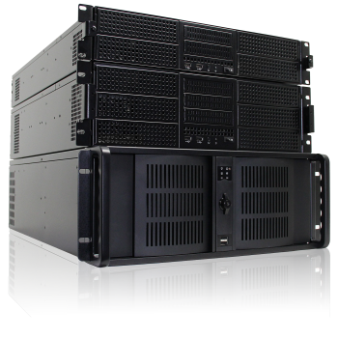

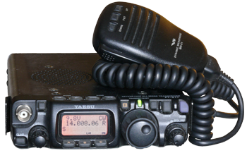

Winlink 2000
Perth, Australia
Brentwood, TN
San Diego, CA
Halifax, NS
Wien, Austria
Common Message Servers (CMS)
5 Mirrored Servers.
Internet
Radio Message Servers (RMS)
Servers maintained by HAMS
around the world. Provides Internet
connection to CMS Servers.
WA7VE-10
Seaside
N7AST-10
Camp Rilea
KD7IBA-10
Warrenton
144.96 MHz
(Satellite to Internet)
TELNET
(No radio
connection)
HAM Radio Stations
Note: Radios require computer interface
K7QPP
AAR0SQ

Slide 7
Winlink 2000 (continued)
Maximum message size, including attachments: 120K bytes (compressed)
  If exceeded, a service message will be sent to the sender
  No limit on number of messages or overall byte size
Attachment name size maximum: 50 characters (including extensions)
  If exceeded, the attachment will not be downloaded nor will an error message be sent
Life of an unread message is 21 days
When a message is downloaded, it is erased from all of the CMS servers
Registration period for a WL2K user: 400 days since last access
K7QPP
AAR0SQ

Slide 8
WinLink system connection
There are four paths a user can connect to the Winlink system
  Via HF radio to one of the RMS hubs
  Via VHF/UHF radio to a local RMS hub
  Via Telenet protocol over the internet
    Terminal emulation program that allows computer users to connect interactively to a server and access remote sites, e.g. on the Internet
  Via Winlink Webmail over the internet
    Like using G-Mail
    Need Winlink e-mail account: “ham call”@winlink.org
K7QPP
AAR0SQ

Slide 9
SOFTWARE
DigiPan – Free software for operating PSK31 and PSK63
FLDIGI – Free software that supports a large number of digital modes (not including JT65 and JT9)
RMS Express – Free software to send message traffic – Also runs WINMOR
Airmail – Free software to send message traffic – Does not run WINMOR
HRD/Digital Master 780 – initial cost plus annual cost if you want upgrades and continued support – supports most digital modes. Has old FREE version.
K7QPP
AAR0SQ

Slide 10
SENDING/RECEIVING MESSAGES
IF YOU CAN SEND AN E-MAIL, YOU CAN SEND A MESSAGE OVER RADIO
VHF/UHF
  PACKET
HF
  PACTOR
  PACTOR II
  PACTOR III
  WINMOR
K7QPP
AAR0SQ

Slide 11
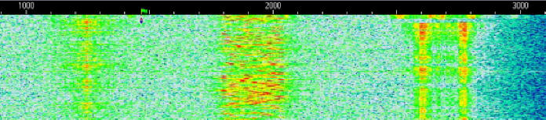
Waterfall recognition
Audio spectrum, left to right: simultaneous Hellschreiber, MFSK and RTTY signals
K7QPP
AAR0SQ

Slide 12

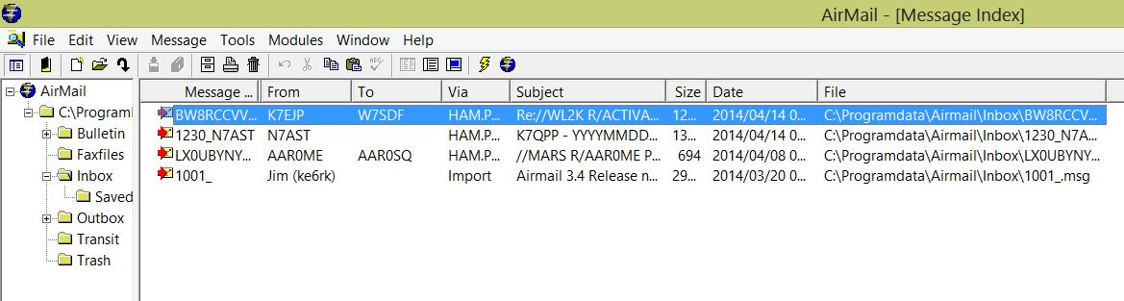
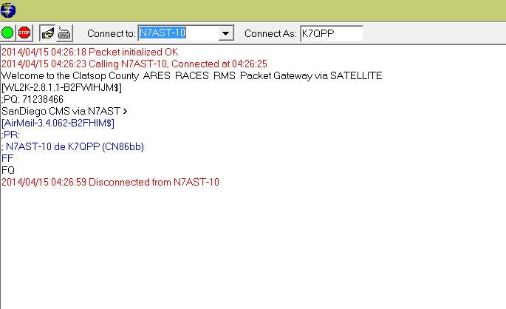
Software - airmail
Original program for sending/receiving WL2K messages
Airmail supports HF Pactor, VHF/UHF Packet, and Telnet
Supports peer-to-peer and connections to RMS Gateways
Limited TNC types supported
Familiar format for e-mail generation
When used with WL2K gateways, Airmail also contains position reporting capabilities, support for downloadable weather, information and help bulletins, and a propagation prediction program
Still in widespread use, especially by the maritime community but setup is less straightforward than newer clients
K7QPP
AAR0SQ

Slide 13

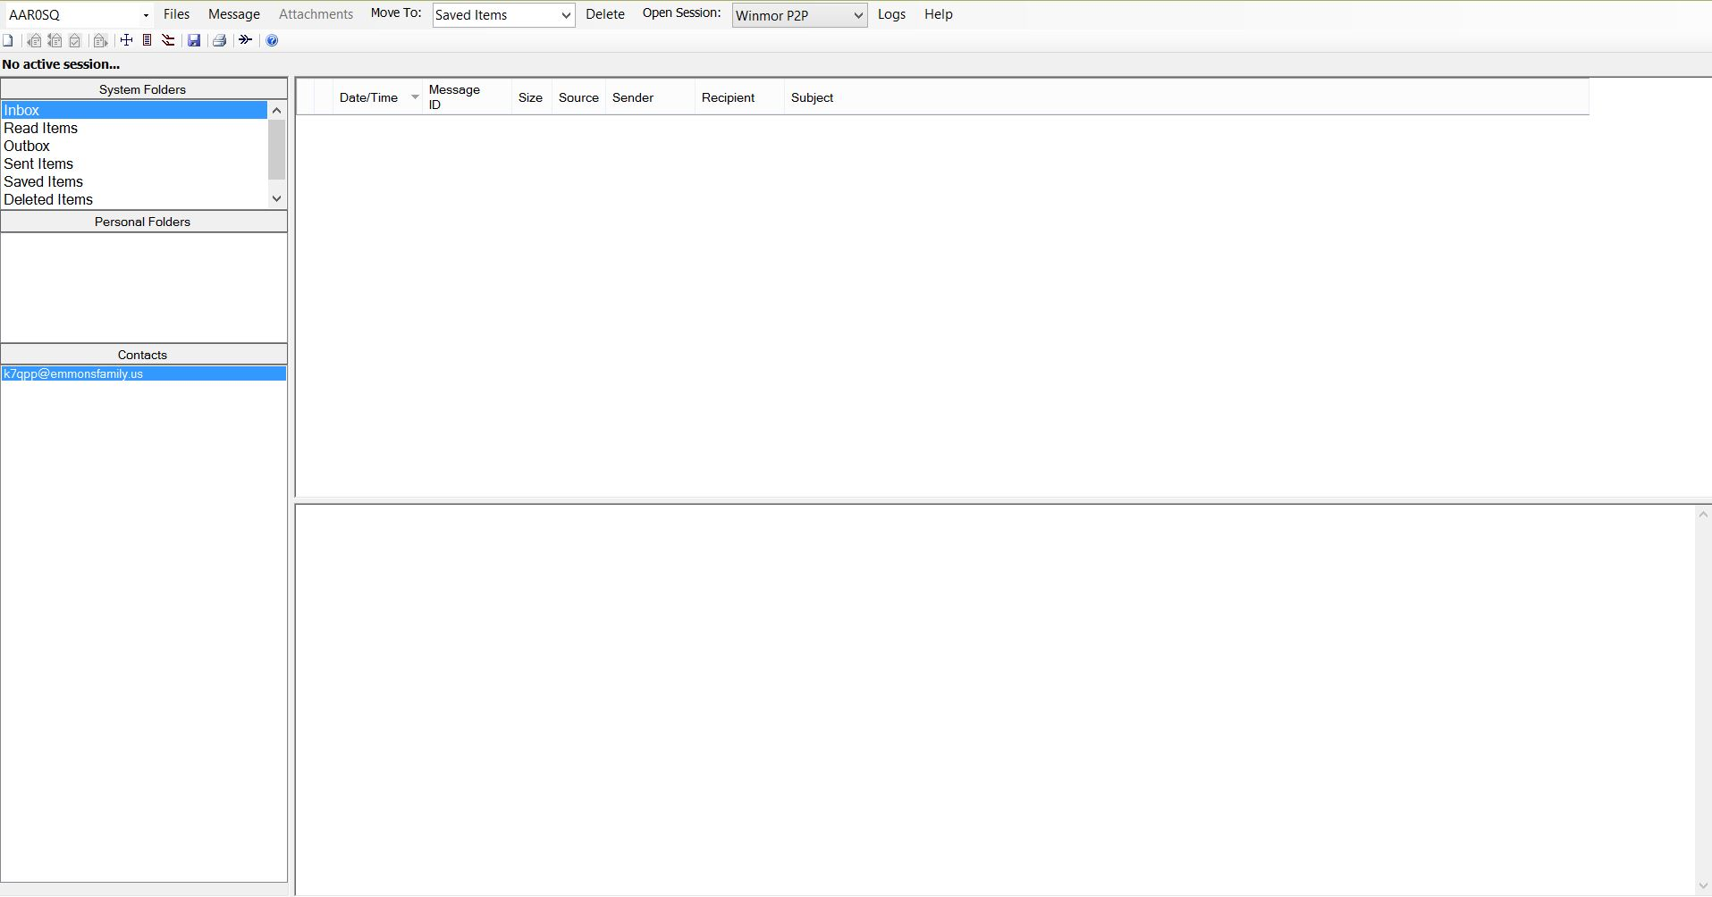
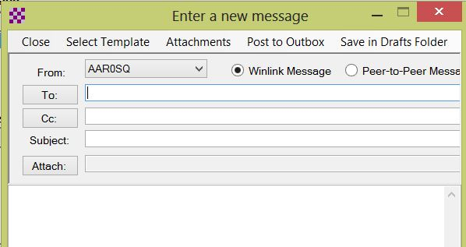
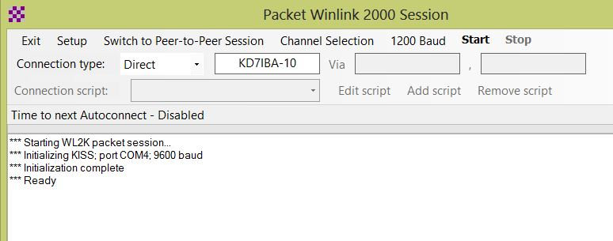
Software – rms express
RMS Express is the preferred Winlink 2000 (WL2K) radio email client.
Supports HF Pactor, HF Winmor, VHF/UHF Packet and Telnet.
Supports RMS Gateways and peer-to-peer connects
Wide variety of TNC types supported, including a generic “KISS” mode
Contains template for over 700 WX and related products
Contains interface for real-time GPS reporting
Setup is simple with automatic program and frequency list updates.
K7QPP
AAR0SQ

Slide 14
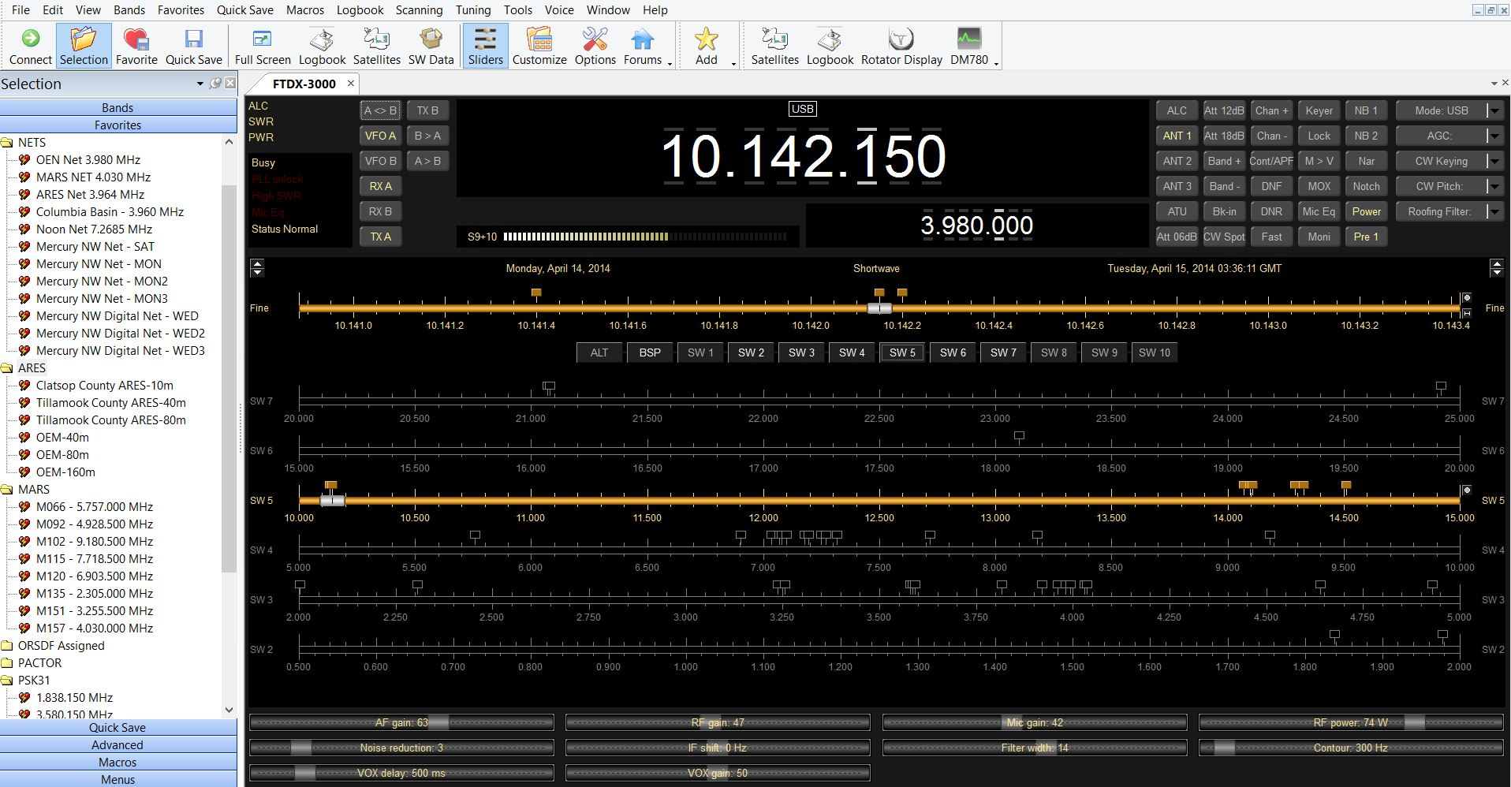
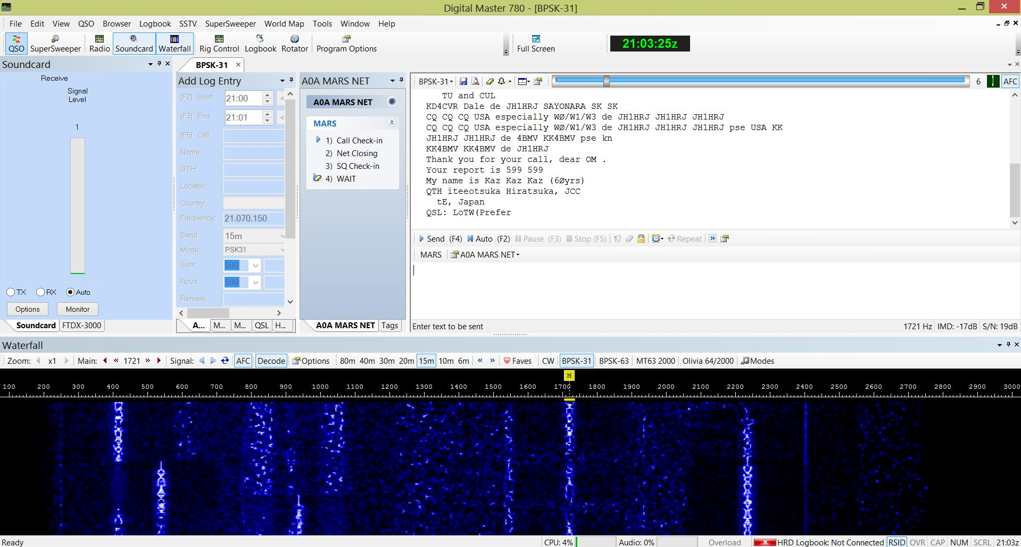
Software - HRD/Digital Master 780
Ham Radio Deluxe (HRD) is an integrated suite of software products for amateur radio. The five modules in the suite provide:
  Rig Control
  Logbook
  Digital Master (DM-780)
    DM-780 provides most popular sound card digital modes with direct integration to Ham Radio Deluxe Logbook.
  Satellite Tracking
  Rotator Control
K7QPP
AAR0SQ

Slide 15
digipan
DigiPan stands for “Digital Panoramic Tuning” and brings the ease and simplicity of PANORAMIC reception and transmission to PSK31 and PSK63 operation. DigiPan provides a panoramic display of the frequency spectrum in the form of an active dial scale extending the full width of the computer screen. Depending upon the transceiver IF bandwidth, it is possible to “see” as many as 40 to 50 PSK31 stations at one time.
K7QPP
AAR0SQ

Slide 16
fldigi
Fldigi is a computer program intended for Amateur Radio Digital Modes operation using a PC (Personal Computer). Fldigi operates (as does most similar software) in conjunction with a conventional HF SSB radio transceiver, and uses the PC sound card as the main means of input from the radio, and output to the radio. These are audio-frequency signals. The software also controls the radio by means of another connection, typically a serial port.
Fldigi is multi-mode, which means that it is able to operate many popular digital modes without switching programs, so you only have one program to learn. Fldigi includes all the popular modes.
K7QPP
AAR0SQ

Slide 17


PACKET
Packet can be used for QSOs, for electronic mail, message transmission or emergency communications.
A HAM needs a transceiver, a computer, and a TNC or special packet modem and software. The TNC is wired between the computer and the radio. It contains software for controlling the outgoing and incoming transmissions for your station and a modem that converts the data from the computer into AFSK tones for transmission and changes the tones that are received by the radio into data for the computer.
Packet is communications between people either direct or indirect. You can work "keyboard to keyboard" or use electronic mailboxes. It has error checking.
The data that is to be transmitted is collected in the TNC and sent as bursts, or packets, of information. Each packet has the callsign or address of who it's going to, who it's coming from and the route between the two stations included, along with the data and error checking. There is also time between packets for several stations to be using the same frequency at the same time.
K7QPP
AAR0SQ

Slide 18

PACTOR
PACTOR is an FSK mode and is a standard on modern TNCs. It is designed with a combination of packet and Amtor Techniques. It is the most popular ARQ digital mode on amateur HF today. This mode is a major advancement over AMTOR, with its 200 baud operating rate, Huffman compression technique and true binary data transfer capability
K7QPP
AAR0SQ

Slide 19
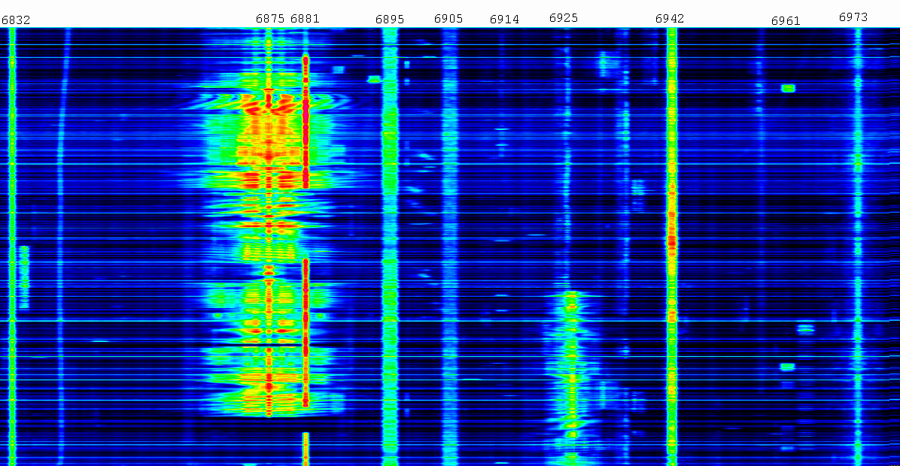
PACTOR II
PACTOR II is a robust and powerful PSK mode which operates well under varying conditions. It uses strong logic, automatic frequency tracking; it is DSP based and as much as 8 times faster then Pactor. Both PACTOR and PACTOR-2 use the same protocol handshake, making the modes compatible
K7QPP
AAR0SQ

Slide 20
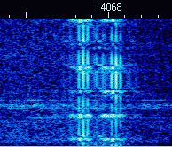
Pactor III
PACTOR-III is a proprietary mode used for message and traffic handling over an HF radio circuit. Use of Pactor-III protocol is limited for US hams and some other countries due to the very wide bandwidth of the Pactor-III signal. Presently digital signals that occupy the bandwidth of PCT-III are restricted to a few sub bands. Only the embedded hardware (modem) from the German company that owns the rights to this mode, is capable of operating Pactor-III.
K7QPP
AAR0SQ

Slide 21
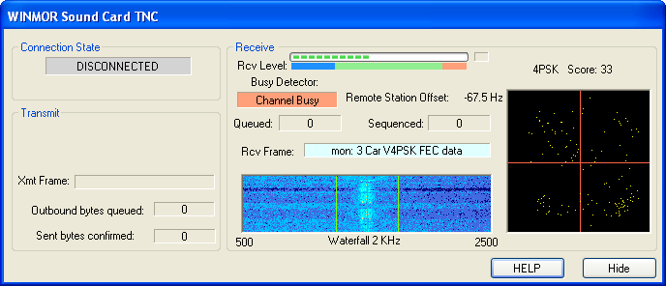
winmor
WINMOR stands for Winlink Message Over Radio and is a new transmission protocol. Unlike Pactor, only a simple computer soundcard to radio interface is required and it runs as a virtual TNC together with host software such as RMS Express. It has fair to good weak signal performance and moderate speed. Some keyboard QSOs to be had but very rare. Peer to Peer exchanges possible when used in WL2K but mostly client to server activity.
K7QPP
AAR0SQ

Slide 22
Pactor vs Winmor
K7QPP
AAR0SQ

Slide 23
How to identify the modes
1. What frequency is it on?
If it is on 7035, 10.100, 14070, 18.100, 21.070, 24.920, 28120, or within 2 KHz of those frequencies, it is almost certainly PSK31 or PSK63. If it is on 7076, 14076, 21076, 28076, it is almost certainly JT65A. PSK31 and JT65A will be at least 75% of what you will hear on the entire HF band, so by learning their frequencies quickly you will be able to discern 75% of all signals.
2. By Sight.
Observing the width of a digital signal will also enable you to quickly narrow in on the possible signals.
  PSK31 should be around 31 Hz wide in your waterfall. To some its like a 31 Hz wide single vertical trace.
  RTTY (in HAM bands) is 170KHz wide and can be seen more clearly as two vertical traces on the waterfall and is typically shows up above 14080, 21080, and 28080 MHz.
  If you can easily tell a PSK31 signal and a RTTY signal , you will recognize 85% of the signals on the band.
3. Hearing.
Your ears can be quite valuable in this regard. The sounds are not easy to describe in writing BUT if you have the software installed, all you need to do is press TRANSMIT (with a dummy load or no radio connected) and you can easily hear what the modes sound like. Some have a different sound if they are just idling, so activate each mode and execute a macro with a CQ in it. Eventually you will easily recognize Hell (a sick CW-like sound), the shrill RTTY sound, or the low roaring noise of MT63 signal. Some modes like Olivia , Contestia, Thor, MFSK16, and Domino sound quite alike.
K7QPP
AAR0SQ

Slide 24
Digital modes (Keyboard conversations)
AMTOR
CW
PSK-31
PSK-63
RTTY
HELLSHREIBER
MFSK16
OLIVIA 64/2000
MT63/2000
THROB-4
JT65A
K7QPP
AAR0SQ

Slide 25
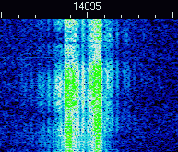
AMTOR
AMTOR is an FSK mode that has been fading into history. While a robust mode, it only has 5 bits (as did its predecessor RTTY) and can not transfer extended ASCII or any binary data. With a set operating rate of 100 baud, it does not effectively compete with the speed and error correction of more modern ARQ modes. The non-ARQ version of this mode is known as FEC, and known as SITOR-B by the Marine Information services.
K7QPP
AAR0SQ

Slide 26
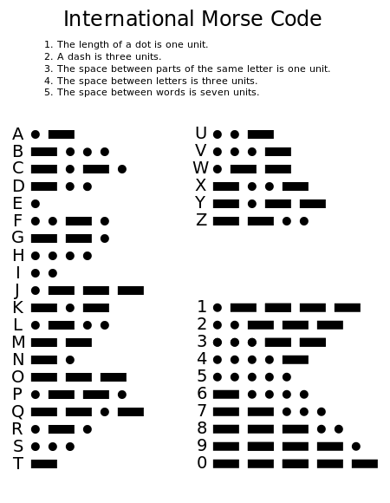
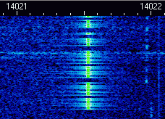
Cw
A continuous wave or continuous waveform (CW) is an electromagnetic wave of constant amplitude and frequency; and in mathematical analysis, of infinite duration. Continuous wave is also the name given to an early method of radio transmission, in which a carrier wave is switched on and off. Information is carried in the varying duration of the on and off periods of the signal, for example by Morse code in early radio.
K7QPP
AAR0SQ

Slide 27
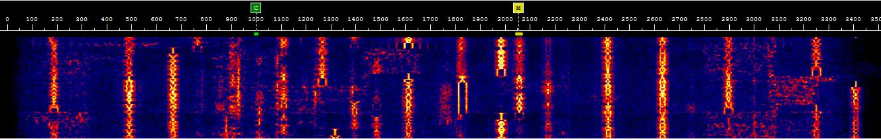
PSK-31 (PHASE SHIFT KEYING)
PSK31 is presently the standard for live keyboard communications. It combines the advantages of a simple variable length text code with a narrow bandwidth phase-shift keying (PSK) signal. A PSK31 signal sounds like a single tone or note with a slight wobble and is used for real-time keyboard-to-keyboard text “chats” over the air at a 31 baud. Most of the ASCII characters are supported. A second version having four (quad) phase shifts (QPSK) is available that provides Forward Error Correction (FEC) at the cost of reduced Signal to Noise ratio.
K7QPP
AAR0SQ

Slide 28
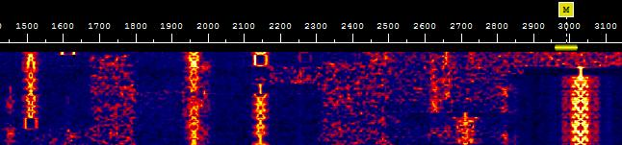
Psk-63 (PHASE SHIFT KEYING)
PSK63 is a new DSP based mode for sending keyboard text over paths that experience fading and interference from other signals. It is accomplished by a complex scheme to encode text in a matrix of 64 tones over time and frequency. This overkill method provides a "cushion" of error correction at the receiving end while still providing a 100 WPM rate. The wide bandwidth (1 kHz for the standard method) makes this mode less desirable on crowded ham bands such as 20 meters. The PSK-63 is the wider signal on the far right of the waterfall, compared to PSK-31.
K7QPP
AAR0SQ

Slide 29
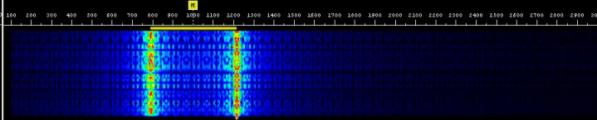
RTTY (shifted to 1000 hz) – RADIO TELETYPE
RTTY or "Radio Teletype" is a FSK mode that has been in use longer than any other digital mode (except for Morse code). RTTY is a very simple technique which uses a five-bit code to represent all the letters of the alphabet, the numbers, some punctuation and some control characters. At 45 baud (typically) and corresponds to a typing speed of 60 WPM. There is no error correction provided in RTTY; weak signals, noise and interference can have a seriously detrimental effect.
K7QPP
AAR0SQ

Slide 30
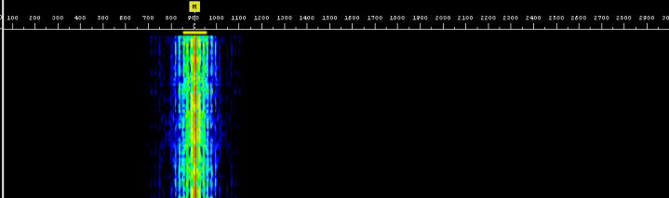
HELLSHREIBER AND FELD-HELL
HELLSCHREIBER is a method of sending and receiving text using facsimile technology. This mode has been around along time; the recent use of PC sound cards as DSP units has increased the interest in Hellschreiber. The single-tone version (Feld-Hell) is the method of choice for HF operation at about a 35 WPM text rate and with a narrow bandwidth (about 75 Hz). Moderate performance in terms of weak signal work.
K7QPP
AAR0SQ

Slide 31
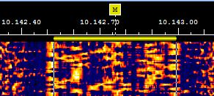
MFSK16
MFSK16 is an advancement to the THROB mode and encodes 16 tones. The PC sound card for DSP uses Fast Fourier Transform technology to decode the ASCII characters, and Constant Phase Frequency Shift Keying to send the coded signal. Continuous Forward Error Correction (FEC) sends all data twice with an interleaving technique to reduce errors from impulse noise and static crashes. Small images can be transferred (typ. 170x128). The relatively wide bandwidth (316 Hz) for this mode allows higher baud rates (typing is about 42 WPM) and greater immunity to multi path phase shift. This mode is becoming a standard for reliable keyboard operation.
K7QPP
AAR0SQ

Slide 32
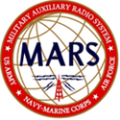
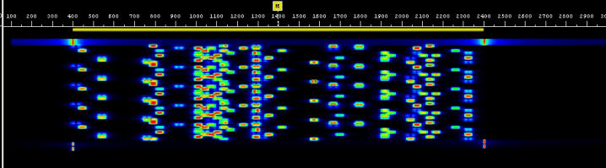
OLIVIA 64/2000
OLIVIA is a new digital MFSK mode and is resistant to fading (QSB) and noise (QRM). It is a combination of MFSK and Forward Error. Olivia has several variants, each having a different bandwidth (from 500Hz to 2kHz) and different number of tones. Olivia can be very slow (in the order of 2-3 characters per second). The standard setting is OLIVIA 8/1000 and 32/1000 but for MARS operation uses OLIVA 64/2000.
K7QPP
AAR0SQ

Slide 33
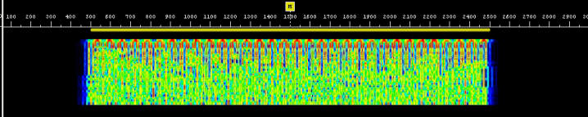
MT63/2000 long
MT63 is a new DSP based mode for sending keyboard text over paths that experience fading and interference from other signals. It is accomplished by a complex scheme to encode text in a matrix of 64 tones over time and frequency. This overkill method provides a "cushion" of error correction at the receiving end while still providing a 100 WPM rate. The wide bandwidth (1 kHz for the standard method) makes this mode less desirable on crowded ham bands.
K7QPP
AAR0SQ

Slide 34
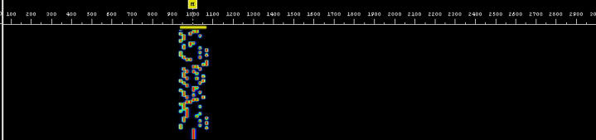
Throb-4
THROB is yet another new DSP sound card mode that attempts to use Fast Fourier Transform technology (as used by waterfall displays) to decode a 5 tone signal. The THROB program is an attempt to push DSP into the area where other methods fail because of sensitivity or propagation difficulties and at the same time work at a reasonable speed. There are 1, 2, or 4 throbs per second, resulting in a text speed that is lower than other modes.
K7QPP
AAR0SQ

Slide 35
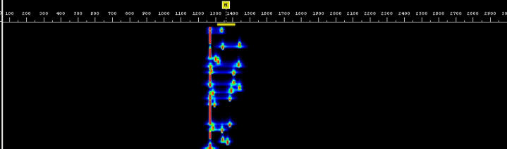
jt65a
JT65A is getting more and more popular. Signals that are virtually inaudible can give perfect copy so its performance is excellent on the noisy HF bands. The transfer rate is slow, as are most modes that excel in low signal decoding. Only very low power is needed to get a signal round the world. Great where it is impossible to erect bigger and more efficient antennas.
K7QPP
AAR0SQ

Slide 36
WHAt you should know
The heart of digital operation is the PC sound card which is being used by the software program as a DSP (Digital Signal Processing) unit.
PSK31 is the most popular of the new DSP modes but will not be the best mode for all band conditions and communication needs. You should try other modes such as MFSK16 and Feld Hell when phase distortion makes PSK31 impractical.
Most SSB transceivers in use today are stable enough for the narrowest of these digital modes. A transceiver that is known to drift slightly during SSB or CW operation may not be suitable for PSK31, but may be used for Hellschreiber modes.
Tuning in a PSK31 or MFSK16 signal is the most frequent complaint by new operators to these modes. The precise tones require precise tuning; but this is made easier with point-n-click features and by AFC techniques built into the programs. Tuning becomes second nature after you get familiar with the sight/sound of your program.
K7QPP
AAR0SQ

Slide 37
Digital ham bands
Predominate USA HF Digital Frequencies
6 Meters: 50.290 – 50.292 MHz
10 Meters: 28.110 – 28.125 MHz
12 Meters: 24.920 – 24.930 MHz
15 Meters: 21.060 – 21.090 MHz
17 Meters: 18.100 – 18.110 MHz
20 Meters: 14.065 – 14.090 MHz
30 Meters: 10.130 – 10.145 MHz
40 Meters: 7.060 – 7.080 MHz
80 Meters: 3.620 – 3.640 MHz
and 3.575 – 3.585 MHz
Legal Wide Band HF Digital Frequencies
(MT-63 and Pactor III modes)
28.120 – 28.189 MHz
24.925 – 24.930 MHz
21.090 – 21.100 MHz
18.105 – 18.110 MHz
14.0950 – 14.0995 MHz
14.1005 – 14.112 MHz
10.140 – 10.150 MHz
7.100 – 7.105 MHz
3.620 – 3.635 MHz
K7QPP
AAR0SQ

Slide 38
Where to Find the Action
80 Meters is very much a winter-time band, normally opening up around sundown. PSK31 activity is very sparse on this band, but you can always expect 1 or 2 QSOs on any given night during Dec/Jan/Feb. Look for activity here particularly during digital contests.
40 Meters (7.073) is where most nighttime digital activity takes place. Again, it’s mostly PSK31, but you will hear more MFSK signals here. This band typically opens around 5 PM and will stay open until about 2 hours after sundown. However, during the winter months, signals can linger after 12 midnight. During DX contests, RTTY will be very active from 7.040 to 7.070.
K7QPP
AAR0SQ

Slide 39
Where to find the action (continued)
20 Meters (14.070) is where 95% of all digital activity takes place at any given time during daylight hours. Of that, most digital operators are using PSK31, but you will find MFSK and occasional Pactor a few KHz up or down from 14.070… just enough to be heard by other PSK31 operators looking to change modes. During the summer months, PSK31 signals can be heard after 12 midnight. RTTY activity is normally centered around 14.080.
15 Meters will occasionally have signals on the air around noon time. DX is surprisingly common on this band, mostly into the Caribbean and South America. Look 10 kHz up to catch some RTTY action as well, around 21.080.
10 Meters will seldom have digital activity, even when the band is open. Expect to use this band only during DX or digital contests.
K7QPP
AAR0SQ

Slide 40
MS-110A mode used by dod
MS-110A requires a program to encode and decode the tones. It needs an accurate sound card and an interface between the sound card and the transmitter. 110A terms:
MS-110A – Serial Tone Waveform (MIL-STD-188-110A)
MS-DMT – Military Standard - Data Modem Terminal Software Program
MARS-ALE – Software tool which allows wide spread MARS integration of Automatic Link Establishment (ALE) capabilities using MS-110A
com0com – Virtual Com Port Emulator – Needed for MARS-ALE and BlockTerm connection to MS-DMT
BlockTerm - Communicates with the MS-DMT using a com0com virtual COM port. Provides “block” error correction capabilities
K7QPP
AAR0SQ

Slide 41

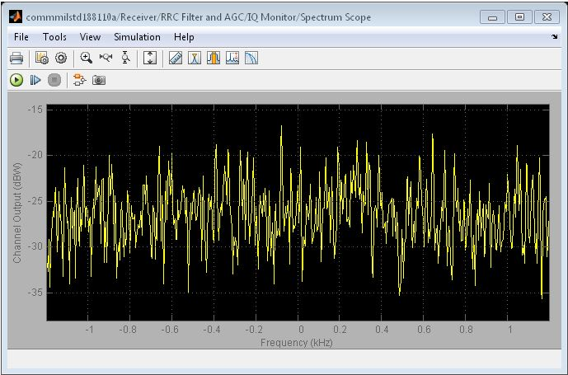
MS-110A serial tone (ST) Waveform
MS-110A is a sophisticated mode that is used by government agencies and the military and typically used with hardware modems ($4K - $10K) connected to military radios. The name 110A comes from the specification that defines the way each baud rate (75 baud to 9600 baud over radio) uses tones. It is limited to MARS as maximum baud rate on HF amateur circuits is limited to 300 baud. The MS-110A waveform puts more demand on the HF transceiver than does MT-63, PACTOR or WINMOR.
K7QPP
AAR0SQ

Slide 42
MIL-std data modem terminal (ms-dmt)
This software application functions as both a MIL-STD modem and data communications terminal and also supports external asynchronous terminal applications. The software currently provides MARS a MIL-STD-188-110A (MS110A) compliant Serial Tone (ST) waveform modem based Message Terminal capability providing message composition and automated message storage to simplify MARS MS110A Forward Error Correction (FEC) message handling
K7QPP
AAR0SQ

Slide 43
MARS automatic link establishment (ALE)
The 110A PC Sound Device based modems to date, such as MARS-ALE and MS-DMT, have been tightly integrated with this application. ALE is a toolbox that holds an entire suite of tools designed to connect stations quickly and pass traffic with accuracy and speed.
“Why is ALE important?” The answer in a word is “interoperability”. The Coast Guard, FEMA and countless other military and federal agencies have adopted ALE as the standard for HF communications.
K7QPP
AAR0SQ

Slide 44
MARS-ALE DISADVANTAGES
ALE was never intended to replace dedicated ALE radios
HAM radios are not designed to use as ALE radios
Most HAM radios will work fine but setup will take some experimentation
Demanding on transceivers band-switching relays that have a finite life
No other software programs should be running as they could interfere with MARS-ALE timing requirements
MARS requires that transceiver be within 20 HZ of assigned frequency
K7QPP
AAR0SQ

Slide 45
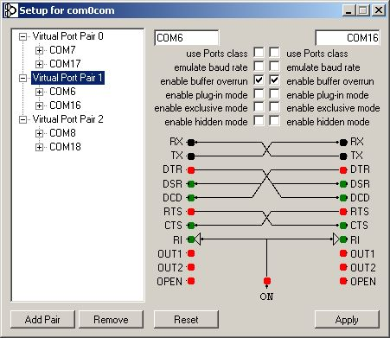
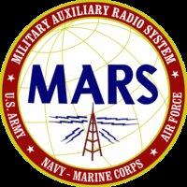
com0com
A virtual COM port software program that allows applications to converse with each other as if they were connected by wires. This program is needed to operate the MS-DMT/ BlockTerminal and MARS-ALE modems.
K7QPP
AAR0SQ

Slide 46
Ms-110A Data message terminal
The MARS-ALE toolset contains an integrated MIL-STD-188-110A modem and FED-STD-1052 Appendix B, Data Link Protocol (DLP) controller capability. MIL-STD modems require two ports for interfacing, one for Data and one for remote control. The basic use of MIL-STD modems are for peer-to-peer and broadcast communications using Forward Error Correction (FEC) and Interleaving to combat the effects of channel Fading, Doppler spread, Multipath and Noise bursts.
All stations must either make use of the same PSK carrier or offset tune their frequency based on the difference between the PSK carrier that they are using and what has been directed for use on the given frequency. If either is not the case, the PSK carriers will not be aligned and communications will not occur.
K7QPP
AAR0SQ

Slide 47
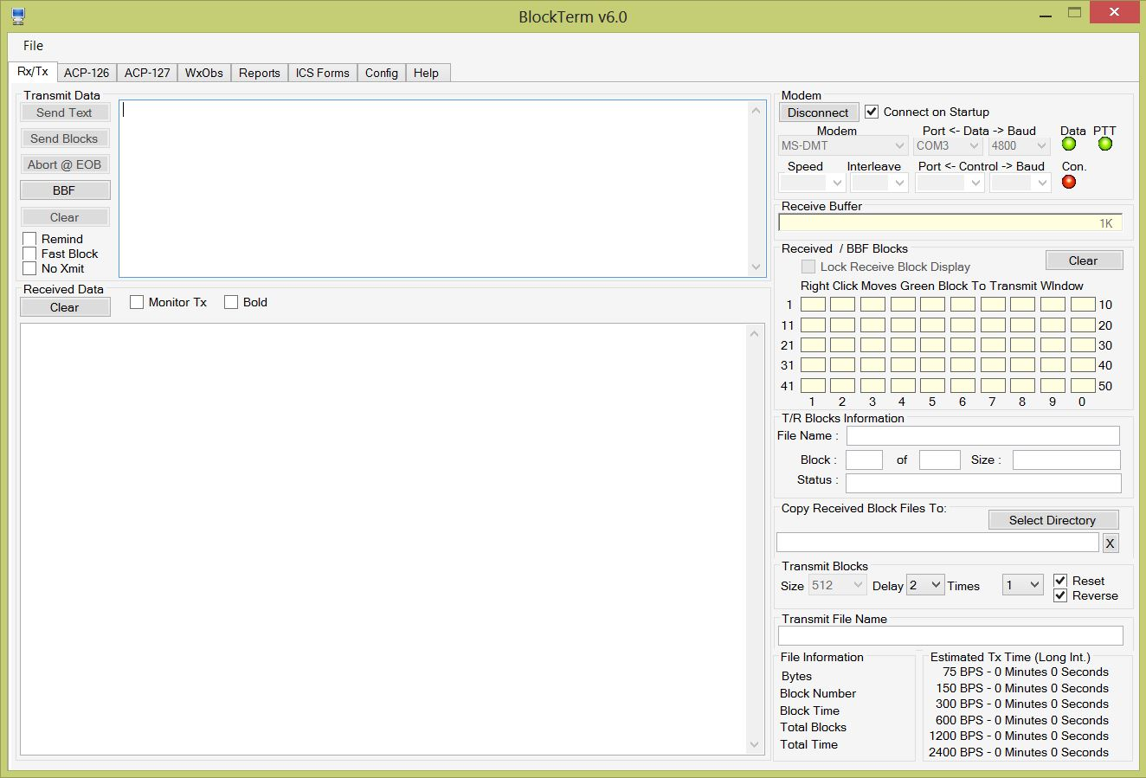
Block terminal
BlockTerm is designed to ameliorate the loss of synchronization by breaking large messages into small blocks and sending all block with a small delay between them. This re-synchronizes the clock before each block making loss of synchronization less likely. When all blocks have been received, the original message is reconstructed. If a block is received with errors, the transmitting station, or any receiving station, can fill the block by retransmitting
just that the block(s) that had errors.
K7QPP
AAR0SQ

Slide 48
Speed comparison of sending various modes
Mode Time
MT63 1K L 251 SEC
MT63 2K L 130 SEC
110 75 BAUD L 330 SEC
110 300 L 90 SEC
110 300 S 80 SEC
110 600 L 49 SEC
Mode Time
110 600 S 40 SEC
110 1200 L 29 SEC
110 1200 S 20 SEC
110 2400 L 19 SEC
110 2400 S 11 SEC
110 4800 N 6 SEC
L = Long, S = Short interleave, N = Not encoded
NOTE: 110A is not as reliable as MT63 but new code is showing real promise.
K7QPP
AAR0SQ

Slide 49
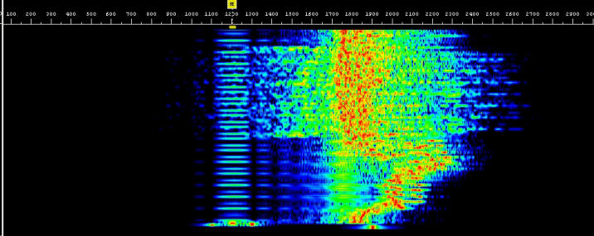

SSTV – Scotty 1 – SLOW SCAN TV
K7QPP
AAR0SQ

Slide 50
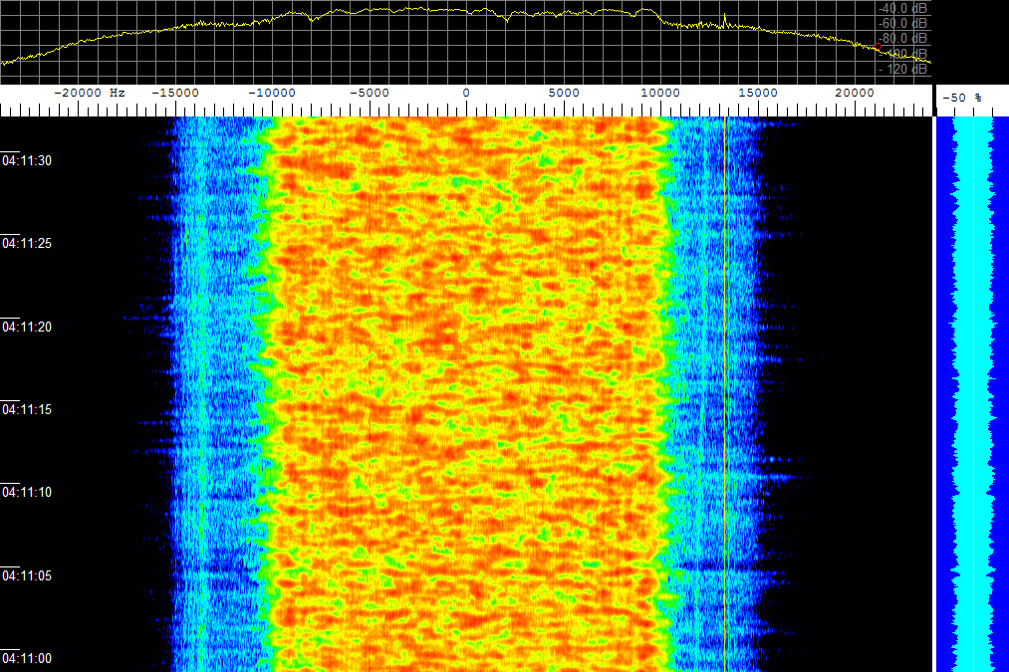
Over-the-horizon fps-118 military radar
The West Coast Sector included an operations center at Mountain Home Air Force Base, Idaho, the transmitter at Christmas Valley, Oregon, and the receiver at Tule Lake, near Alturas, California. (Opened in 1985 and closed in warm storage in 1997 (24 month recall) and then cold storage in 2007. It transmitted 100 Million Watts between 5 – 28 MHz).
K7QPP
AAR0SQ

Slide 51
DIGIPEATERS
Digipeater is the term used to describe a packet radio digital repeater. Unlike the FM voice repeaters, most digipeaters operate on simplex and do not receive and transmit simultaneously. They receive the digital information, temporarily store it and then turn around and retransmit it. Your TNC can be used by others as a digipeater if you have the command DIGIPEAT turned ON.
You use a digipeater by entering its callsign after a V or VIA in your connect sequence. Your TNC will allow you to enter up to eight digipeaters but using more than 3 usually means long waits, lots of repeated packets and frequent disconnects, due to noise and other signals encountered on the frequency.
When entering the list of digipeaters in your connect sequence, you must make sure that you enter them in the exact order that your signal will use them. You must separate the calls by commas, without any spaces, and the EXACT callsigns must be used, including the SSID, if any. That means you need to know what digipeaters are out there before you begin randomly trying to connect to someone. Turn MONITOR ON and watch for the paths that other stations are using.
Something to remember when using digipeaters is the difference between making a connection and sending information packets. If the path isn't all that good, you might be able to get a connect request through, but will have a difficult time with packets after that. The connect request is short so it has much less of a chance of being destroyed by noise or collisions than a packet containing information. Keeping information packets short can help keep retries down when the path is less than ideal.
K7QPP
AAR0SQ

Slide 52
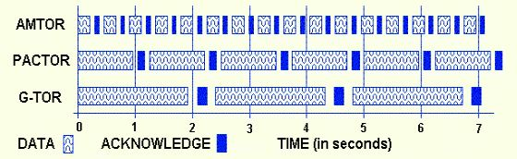
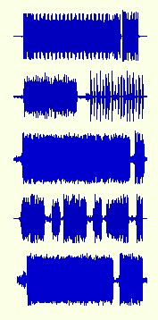
Digital Ham modes
PACTOR: Windows Wave file 8-bit recording (79K), 11K sample rate (6.7 seconds)
CLOVER: Windows wave file 16 bit recording (74K) 22K sample rate (6.75 seconds). MS ADPCM compression.
G-TOR: Windows wave file 8 bit recording (76K), 8K sample rate (9.7 seconds).
AMTOR: Windows wave file 8 bit recording (54K), 8K sample rate (6.7 seconds).
PACTOR II: Windows wave file 8 bit recording (54K), 11K sample rate (4.96 seconds), no compression.
ARQ modes: Observe the sending stations data pulse followed immediately by the receiving stations short acknowledgement pulse.
K7QPP
AAR0SQ

Slide 53


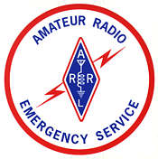
Questions?
K7QPP
AAR0SQ

Slide 54
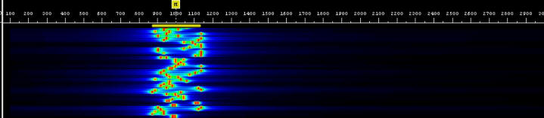
DOMINO EX-8
DominoEX is a digital mode using MFSK (Multi-Frequency Shift Keying), used to send data (for example, hand-typed text) by radio. MFSK sends data using many different tones, sent one at a time. Each tone element ('symbol') can carry several bits of data. Most other digital modes uses each tone to represent only one bit. Thus the symbol rate is much lower for the same data rate when MFSK is used. This is beneficial, since it leads to high sensitivity with good data rate and modest bandwidth. More importantly, low symbol rates are less effected by multi-path reception timing effects. Therefore MFSK is ideal for HF operation since it has good noise rejection and good immunity to most propagation distortion effects which adversely affect reception of other modes.
K7QPP
AAR0SQ

Slide 55
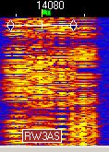
CONTESTIA
Contestia is a digital mode directly derived from Olivia that is not quite as robust - but more of a compromise between speed and performance. Contestia has 40 formats just like. The formats vary in bandwidth (125,250,500,1000, and 2000hz) and number of tones used (2,4,8,16,32,64,128, or 256). The most commonly used formats right now seem to be 250/8, 500/16, and 1000/32.
K7QPP
AAR0SQ

